Slide 1
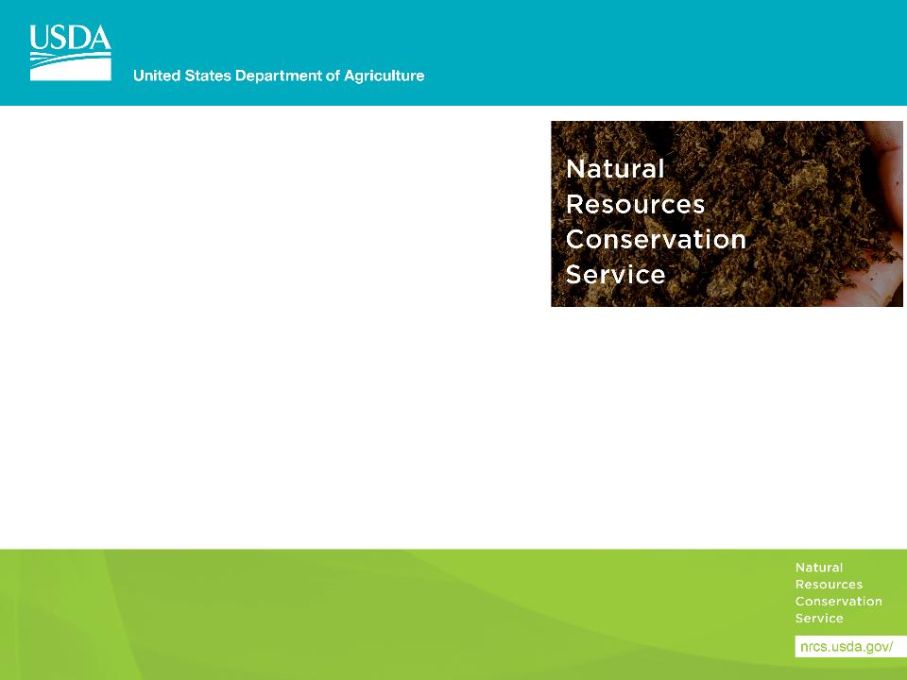
Conservation Assessment Ranking Tool Soils
May 2, 2019

Slide 2
How is Geospatial Data Used in CART

Slide 3
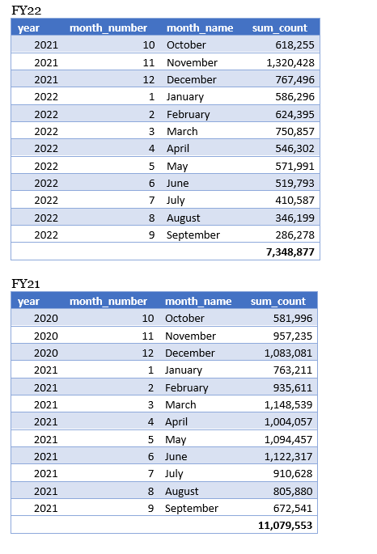
Usage

Slide 4
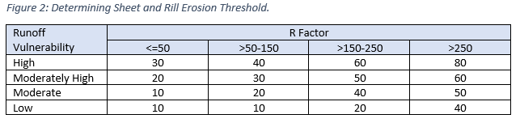
Threshold
Measure of Intrinsic Site Vulnerability and amount of conservation effort to reach a “sustainable” level
From NB 440-19-9, Attachment A – CART Resource Concern Assessment
Soil Erosion – Sheet and Rill

Slide 5
Soil Quality Degradation
CART has four resource concerns related to Soil Quality Degradation and each will involve analysis of soil interpretation data from the Soil Data Access Query service. Soil maps and reports for these interpretations are also available from Web Soil Survey. Both applications are connecting to the same soils database.
 | Resource Concern | Soil Interpretation
1 | Subsidence | Agricultural Organic Soil Subsidence
2 | Compaction | Soil Susceptibility to Compaction
3 | Organic Matter Depletion | Organic Matter Depletion
4 | Concentration of Salts and Other Chemicals | Surface Salt Concentration

Slide 6
Soil Data Access Requests by CART
The request for soils data begins once landunits have been selected.
The request is in the form of an SQL query and contains:
Landunit identifier
Bounding coordinates
CART will automatically send the request to Soil Data Access Query Service.
Map layers are processed in the background and will not be displayed.
Park County, Wyoming (245 acres)

Slide 7
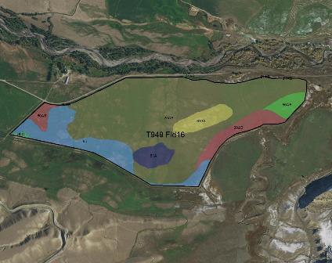
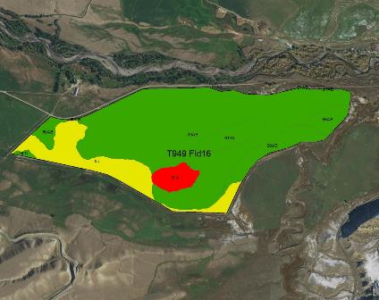
Map data is processed in the background
Basic Soil Map
Risk of Surface Salt Concentration
The map on the left shows 8 different soils within this landunit. The map on the right side illustrates risk of surface salinization. The red polygon indicates an area of high risk for surface salinization, yellow areas have a moderate risk and green areas are low risk.

Slide 8
Service Data
In the example below, the Query service has returned soils data for the ‘Risk of Surface Salt Concentration’ within the landunit. The rating data shown in table below is then used to calculate the magnitude of each rating as both a landunit percentage and as landunit acres.
Landunit | Soil Interpretation Name | Soil Interpretation Rating | Rating Number | CART Rating | Rating Percent | Rating Acres | Land Unit Acres | Rolling Percent | Rolling Acres
T949 Fld16 | Surface Salt Concentration | High surface salinization risk or already saline | 1 | Surface Salt Concentration:1 | 3.9 | 9.54 | 244.78 | 3.9 | 9.54
T949 Fld16 | Surface Salt Concentration | Surface salinization risk | 2 | Surface Salt Concentration:2 | 15.2 | 37.20 | 244.78 | 19.1 | 46.74
T949 Fld16 | Surface Salt Concentration | Low surface salinization risk | 3 | Surface Salt Concentration:3 | 80.9 | 198.04 | 244.78 | 100.0 | 244.78
Areas with the highest risk will be assigned a rating number of 1. Areas with a lower risk will be assigned a larger rating number. Rating values are calculated using soils data at the component level.

Slide 9
Landunit Detailed Ratings
The service request then calculates the rolling sum values for rating_acres and rating percent for each resource concern and finds the single most limiting rating (per landunit) that comprises at least 10% by area or 10 acres.
Landunit | Soil Interpretation Name | Soil Interpretation Rating | Rating Number | CART Rating | Rating Percent | Rating Acres | Land Unit Acres | Rolling Percent | Rolling Acres
T949 Fld16 | Surface Salt Concentration | High surface salinization risk or already saline | 1 | Surface Salt Concentration:1 | 3.9 | 9.54 | 244.78 | 3.9 | 9.54
T949 Fld16 | Surface Salt Concentration | Surface salinization risk | 2 | Surface Salt Concentration:2 | 15.2 | 37.20 | 244.78 | 19.1 | 46.74
T949 Fld16 | Surface Salt Concentration | Low surface salinization risk | 3 | Surface Salt Concentration:3 | 80.9 | 198.04 | 244.78 | 100.0 | 244.78
In this example, it is the second row that meets these criteria and will be provided to the CART application as the landunit rating for Concentration of Salts and Other Chemicals. It is important to understand that the functionality for calculating landunit ratings is not available from Web Soil Survey. It is only designed to provide soil maps and reports.

Slide 10
Final Landunit Ratings
The final Soil Data Access landunit ratings for each of the resource concerns will be returned to CART for awarding of points. The publication date of the soils data will also be returned to CART as metadata. This will ensure that any of the Soil Quality Degradation ratings can be tied back to a particular version of SSURGO soils data.
Landunit | Landunit Ratings | Soil Survey Publication Date
T949 Fld16 | Agricultural Organic Soil Subsidence:4 | WY629 2018-09-14 18:51:24
T949 Fld16 | Organic Matter Depletion:2 | WY629 2018-09-14 18:51:24
T949 Fld16 | Soil Susceptibility to Compaction:1 | WY629 2018-09-14 18:51:24
T949 Fld16 | Surface Salt Concentration:2 | WY629 2018-09-14 18:51:24

Slide 11
This domain table contains an ordered list of all possible rating values.
Line | CART Rating | Soil Interpretation Name | Soil Interpretation Rating Class | Rating Number
1 | Surface Salt Concentration:1 | Surface Salt Concentration | High surface salinization risk or already saline | 1
2 | Surface Salt Concentration:2 | Surface Salt Concentration | Surface salinization risk | 2
3 | Surface Salt Concentration:3 | Surface Salt Concentration | Low surface salinization risk | 3
4 | Surface Salt Concentration:4 | Surface Salt Concentration | Not rated | 4
5 | Soil Susceptibility to Compaction:1 | Soil Susceptibility to Compaction | High | 1
6 | Soil Susceptibility to Compaction:2 | Soil Susceptibility to Compaction | Medium | 2
7 | Soil Susceptibility to Compaction:3 | Soil Susceptibility to Compaction | Low | 3
8 | Soil Susceptibility to Compaction:4 | Soil Susceptibility to Compaction | Not rated | 4
9 | Organic Matter Depletion:1 | Organic Matter Depletion | OM depletion high | 1
10 | Organic Matter Depletion:2 | Organic Matter Depletion | OM depletion moderately high | 2
11 | Organic Matter Depletion:3 | Organic Matter Depletion | OM depletion moderate | 3
12 | Organic Matter Depletion:4 | Organic Matter Depletion | OM depletion moderately low | 4
13 | Organic Matter Depletion:5 | Organic Matter Depletion | OM depletion low | 5
14 | Organic Matter Depletion:6 | Organic Matter Depletion | Not rated | 6
15 | Agricultural Organic Soil Subsidence:1 | Agricultural Organic Soil Subsidence | Severe subsidence | 1
16 | Agricultural Organic Soil Subsidence:2 | Agricultural Organic Soil Subsidence | Moderate subsidence | 2
17 | Agricultural Organic Soil Subsidence:3 | Agricultural Organic Soil Subsidence | Low subsidence | 3
18 | Agricultural Organic Soil Subsidence:4 | Agricultural Organic Soil Subsidence | Mineral soil | 4
19 | Agricultural Organic Soil Subsidence:5 | Agricultural Organic Soil Subsidence | Not rated | 5
20 | Suitability for Aerobic Soil Organisms:1 | Suitability for Aerobic Soil Organisms | Not favorable | 1
21 | Suitability for Aerobic Soil Organisms:2 | Suitability for Aerobic Soil Organisms | Somewhat favorable | 2
22 | Suitability for Aerobic Soil Organisms:3 | Suitability for Aerobic Soil Organisms | Very favorable | 3
23 | Suitability for Aerobic Soil Organisms:4 | Suitability for Aerobic Soil Organisms | Not rated | 4

